Slide 1
State and Federal Relations
Prepared by Charles Brown

Slide 2
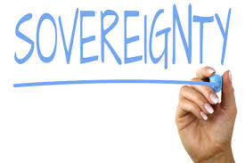
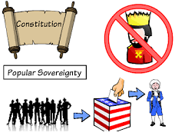
Sovereignty is the supreme authority of a governing body to govern itself independently.
Who has the supreme authority? Is it the Constitution, the People or the State?

Slide 3
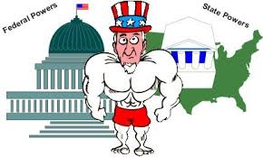
Supreme Authority
A state e.g. United States has the supreme authority because it is an entity of a territory. National governments delegate the power e.g. to local police, but the authority to use force originates from the State’s permission. In this case, the state like Washington DC has the supreme authority.

Slide 4

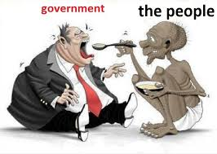
How sovereignty relates to different types of relationships
Sovereignty between a small government and the people
Sovereignty between a big government and the people

Slide 5
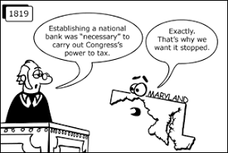
Cont….. Unitary-Centralized Government
Unitary Relationship between the government and the local authorities e.g. Maryland. While the national government may propose various state functions, the state has the authority to question or validate the functions as long as they affects it. This government is created out of convenience.

Slide 6
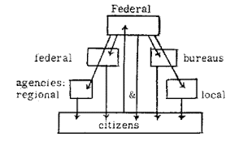
Federal
Power is divided between central government and the local governments. The National government of the United States has its powers while 50 States also have their own powers.

Slide 7
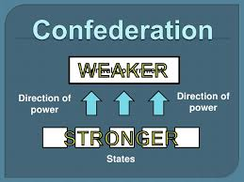
Confederate
Confederacy is an alliance of independent states. In the United States, 50 States are not independent, but in the past some states were sovereign countries.
In confederacy, the central government had limited powers, the government does not have power to make laws that directly apply to the people.

Slide 8

Federal Government is my choice
I would like to live under the federal government because it allows powers to be divided among the central government and local governments. Another reason is because division of power cannot be changed by either acting alone.

